Slide 1
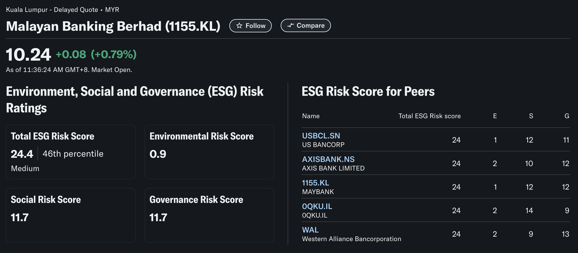
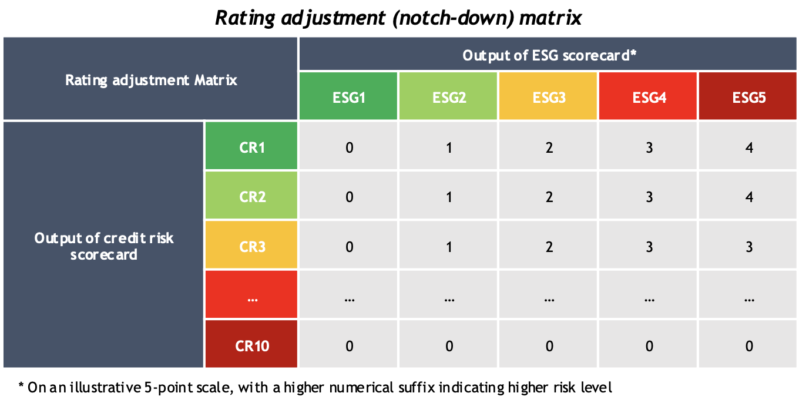
Initial Approach
ML model to calculate an internal Credit Rating
ESG Scores
Fig. Maybank ESG Rating from yahoo!finance
Credit Ratings
Financials
Notes:
Initial approach we took
Work Done:
- Analysed correlations between ESG metrics and credit ratings.
Objective: Develop a predictive model for internal credit rating using ESG and financial data.

Slide 2
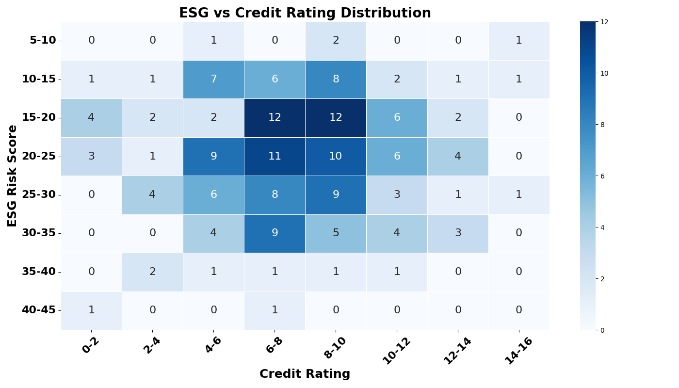
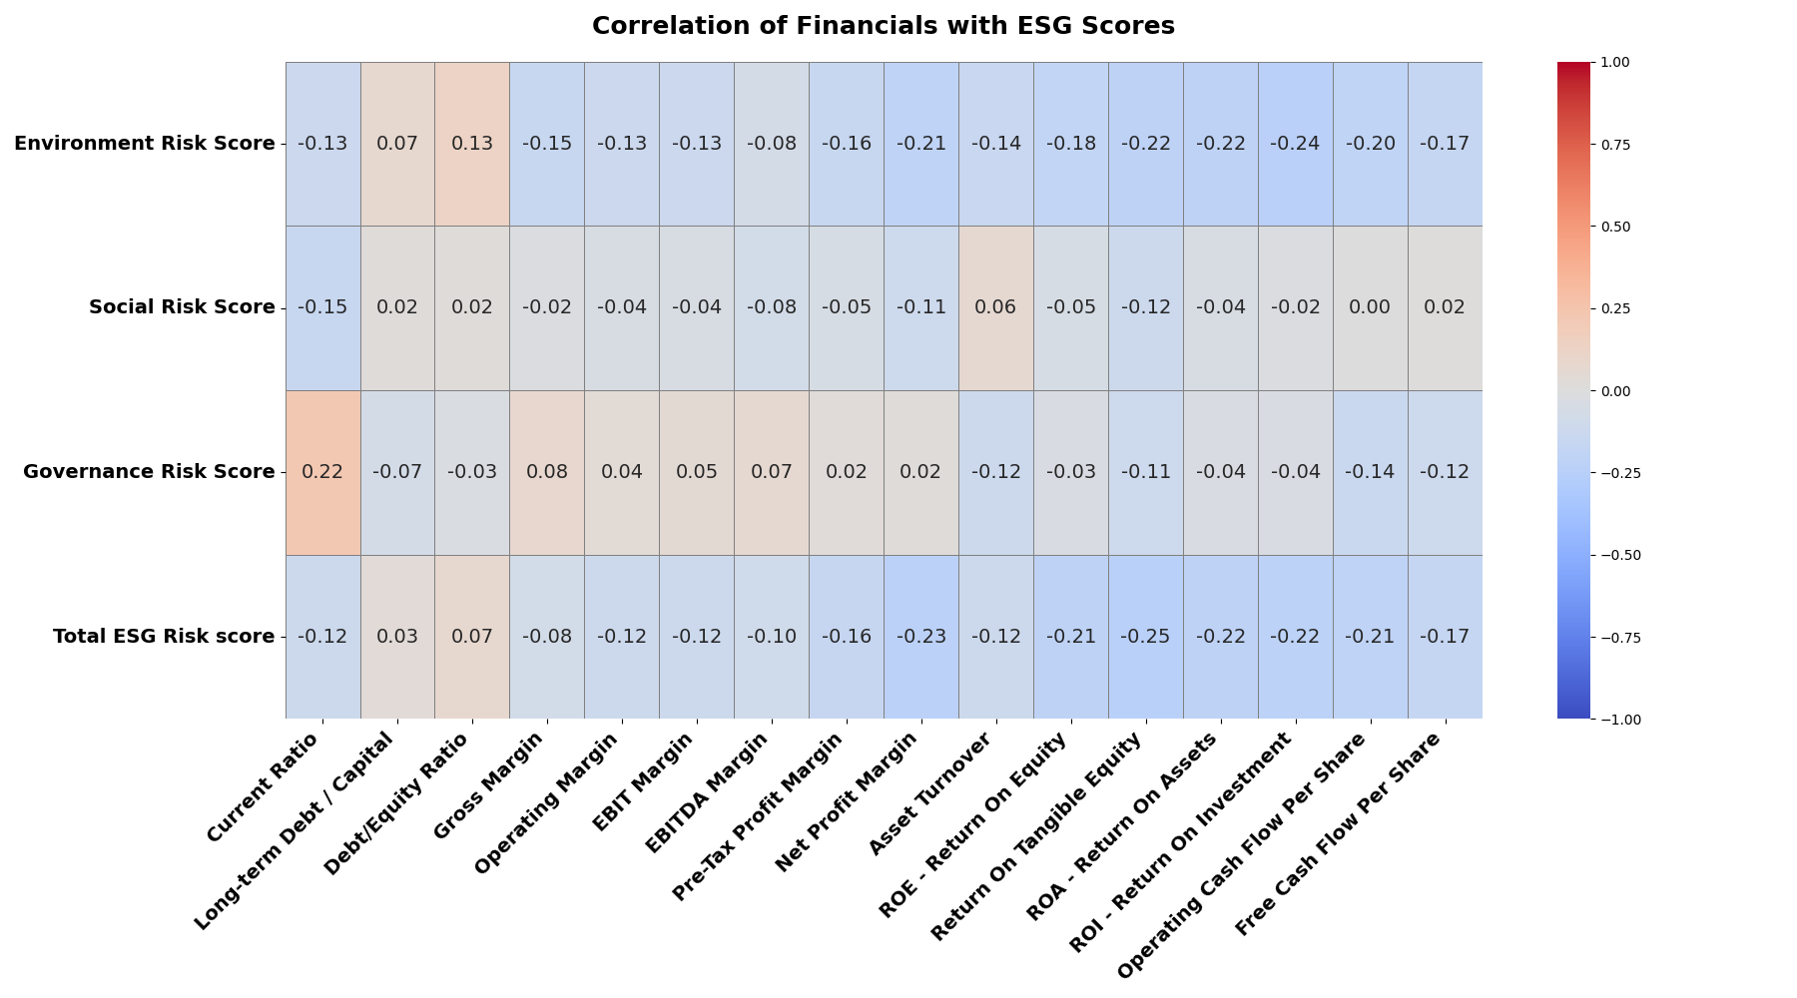
Cross Distribution of customer for credit rating vs ESG score
Dataset (‘combined_data’) includes 181 rows, variables included: ‘Total ESG Risk Score’, (credit) ‘Numerical Rating’) – converted from ‘Rating’
1. No Strong Linear Trend
While there is some clustering, there is no clear linear relationship between ESG risk and credit rating. Companies with both good and bad credit ratings are spread across different ESG risk levels, suggesting other factors influence creditworthiness beyond ESG considerations.
2. Highest Density Cluster
The densest region appears around ESG scores 20-25 and credit ratings 6-10, indicating that most companies in this dataset have moderate ESG risk and mid-tier credit ratings.
Moderate Negative Correlations
More profitable firms tend to have lower ESG risk scores, especially:
Net Profit Margin vs Total ESG Risk Score (r ≈ -0.33)
ROA, ROI, EBIT Margin vs Total ESG Risk Score (r ≈ -0.26 to -0.29)
Gross Margin, Operating Margin, EBIT Margin vs Environment Risk Score (r ≈ -0.35 to -0.39)
Suggests that financial efficiency aligns with better ESG performance, particularly in environmental aspects
Notes:
Collected ESG risk scores from S&P for large U.S.-based companies, financial metrics and credit ratings.
Goal was to explore whether ESG performance is reflected in a company’s creditworthiness and financials.
ESG scores don’t strongly predict credit ratings in this dataset, they are moderately aligned with financial efficiency
supports the idea that ESG factors may signal operational success, but aren’t yet fully integrated into traditional credit scoring mechanisms

Slide 3
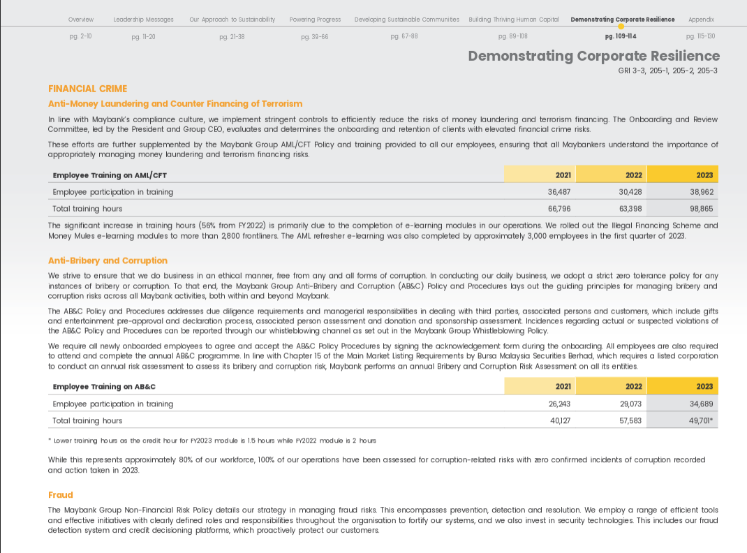
Use Case Overview
LLM to automatically extract ESG metrics
ML model to calculate ESG score
ESG Reports
ESG Metrics
ML model to calculate an internal Credit Rating
Company sustainability reports
Those found in ESGpedia reports
ESG Scores
ESGpedia reports
Follows Morningstar’s ESG Rating
Credit Ratings
Environmental Metrics:
Fuel Consumption (Mobile Combustion)
Fuel Consumption (Stationary Combustion)
Electricity Consumption
Water Consumption
Waste Disposed (Non-hazardous)
Waste Disposed (Hazardous)
Scope 1 Emissions
Scope 2 Emissions
Emissions Intensity
Financials
Social Metrics:
Current Employee by Age Group (Under 30, 30-50, Over 50)
Current Employee by Gender (Male, Female)
Total Number of Current Employees
Total number of new employees hired by age group & gender
Number of fatalities as a result of work-related injury
Number of high-consequence work-related injuries
Number of recordable work-related injuries
Number of recordable work-related ill-health cases
Average training hours per employee (Total, Male, Female)
Type and scope of programs implemented to upgrade employee skills
Employees who received a performance and career review (by gender)
Fig. Maybank’s Sustainability Report 2023
Governance Metrics:
Number of Independent Board Directors
Number of Women on the Board of Directors
Anti-corruption policy presence
Number of operations assessed for corruption risks
Significant risks related to corruption identified
Number and percentage of governance body members trained on anti-corruption
Number and percentage of employees trained on anti-corruption
Notes:
Another use case:
ESG scores that we have worked with are from Morningstar
Not all companies have a rating, especially RSMEs
Formulate our own ESG score
Internally we have ESGpedia
Sample
In the event the ESGpedia report is unavailable
Way to extract metrics from sustainability reports
- Usually biannually released

Slide 4

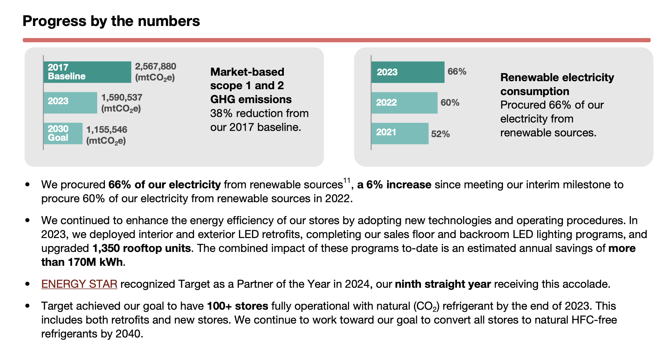

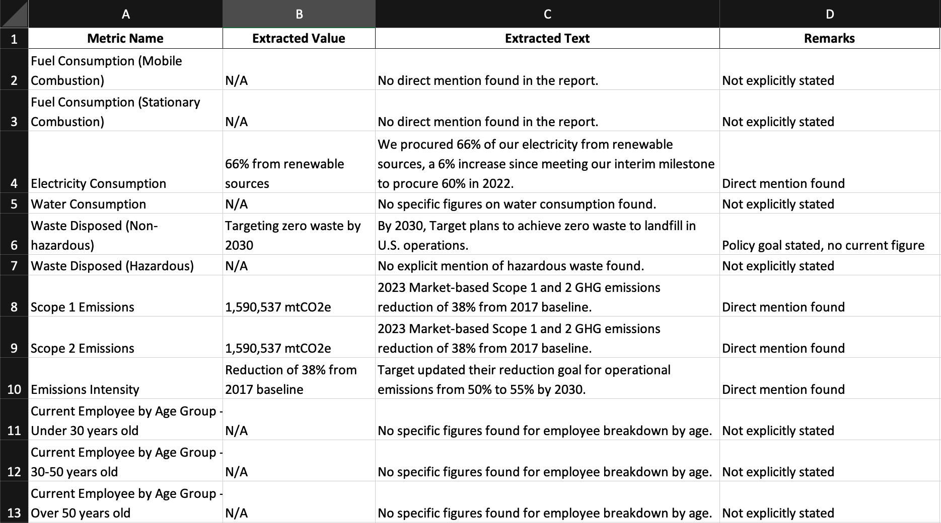
ESG Metric Extraction Framework
Task Overview: Framework is designed for an AI model to analyse ESG (environmental, social and governance) reports and extract key ESG metrics based on a predefined list. Extracted data is then structured into an Excel file for further analysis
1. Input company sustainability report and framework scans the text for key metrics
2. Extract numerical values if explicitly stated
3. Use NLP techniques to infer or calculate estimates when direct values are missing
4. Provide context by including relevant supporting text, and include remarks when information is inferred or indirectly mentioned.
Notes:
The text is parsed using a predefined list of ESG metrics
The system then scans the document for explicit mentions of these metrics using keyword and regex-based pattern matching.
If numerical values are clearly stated, the system directly extracts them and logs them into a structured table along with the extracted snippet .
When numbers aren’t directly reported, we apply NLP techniques such as named entity recognition (NER), co-reference resolution, and sentence-level semantic matching to infer values or flag sections for further human validation
For completeness, the output also stores supporting text and remarks.

Slide 5
Output Format, LLM Techniques for extraction and Expected Response
LLM Techniques for Extraction
Identify percentages, proportions, or related numerical statements.
Convert numbers mentioned in text format into numerical values.
Cross-check other sections of the report for implied figures.
Identify qualitative statements suggesting approximate values.
Expected Response
File Format: Downloadable Excel File
Conditions:
If a metric is not found, use NLP to deduce possible values.
Provide remarks explaining whether the value was estimated, inferred, or unavailable.
Future Improvements:
Enhance metric categorisation – add brief descriptions for each category, such as “Environmental Metrics: Metrics related to resource usage, emissions and employee development”
Expanding LLM models to handle industry-specific terminology, integrating external data sources for validation and improving inferential accuracy for missing metrics.
For reports with very little values for metrics found in ESGpedia’s reports, it will output suggestions for similar metrics.
Output Format
File Type: Excel (.xlsx)
File Naming Convention: {Report Name}_Extracted_ESG_Metrics.xlsx
Columns in the Output File:
Metric Name – The ESG metric extracted
Extracted Value – The numerical or qualitative value found
Extracted Text – Supporting text from the report
Remarks – Notes on whether the value was directly found, estimated, or inferred
Notes:
LLM: Chat-4o

Slide 6

Future Actions

